Slide 1
Deckster Smart Flashcards
Our flashcards are better than your flashcards

Slide 2
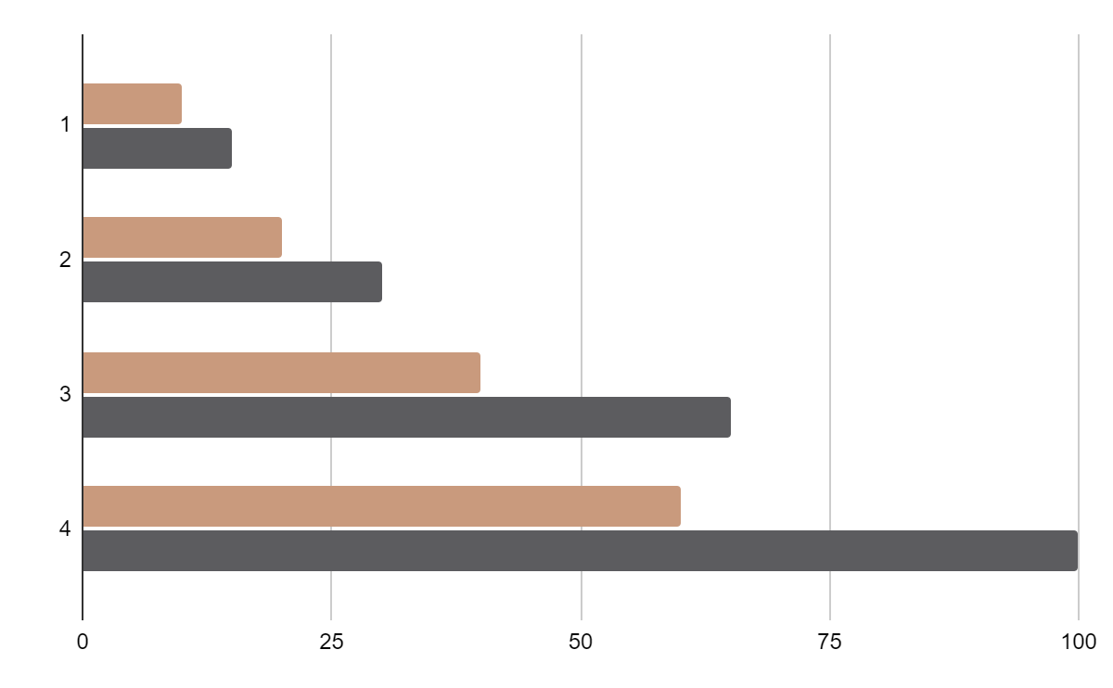
The Hook
Mercury is the closest planet to the Sun and the smallest one in the Solar System The planet’s name has nothing to do with the liquid metal
The Sun is the star at the center of the Solar System
Jupiter is the biggest planet in the entire Solar System
Saturn is composed mostly of hydrogen and helium
Mercury
Venus
It’s the closest planet to the Sun
Venus has a beautiful name
Follow the link in the graph to modify its data and then paste the new one here. For more info, click here
Notes:
Fill this out with the Hook

Slide 3
We Have Something to Share
01
02
03
04
05
06
Introduction
Concept
Process
Who are we?
Why are we here?
How did we do it?
Demonstration
Development
Questions
When do we get to see it?
Where do we go from here?
What else?

Slide 4
01
Introduction
…of the Team that Needs No Introduction

Slide 5

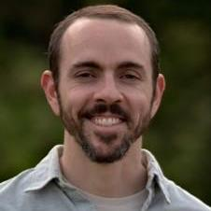


Teamwork Makes The Dreamwork
Jaden Szewczak
Stuart Gross
CSV Import Implementation, UI/UX Design, Theming & Styling, Accessibility, GraphQL Integration
Backend Architecture, Study Session Features, Performance Analytics, Database Design, Deployment
Antonina Stancheva
Jonathan Hummer
Frontend Development, Component Architecture, UI/UX Design, Redux Integration, Search Features
Full Stack Development, Authentication & Security, Profile Management, Team Organizer
Notes:
Jaden: Hi everyone! My name is Jaden Szewczak, and I’m from Philadelphia, Pennsylvania. I spent two years automating processes through VBA and SQL in my previous logistics role, and recently, was scouted by the tech division at my company to join their team. I accepted the role and moved to Edison, New Jersey to start the next chapter of my life. 🥳
Stuart: A dedicated software developer transitioning from a decade-long career as a full-time electrical engineer, bringing a strong analytical mindset, problem-solving skills, and a deep understanding of complex systems. With a passion for coding and a keen eye for detail, they leverage their engineering background to write efficient, scalable software solutions. Eager to contribute fresh perspectives and technical expertise, they are committed to continuous learning and innovation in the ever-evolving world of software development.
Antonina: With a degree in Finance, Antonina initially explored the world of finance, but soon discovered her passion lies in coding. As a JavaScript developer, she loves creating complex functionalities in a simple and understandable way, while also enjoying the challenge of hunting and resolving bugs.
Jonathan: Jonathan has a demonstrated history of using his computer programming skills and logic to implement automation in business processes and reporting and develop forms and applications for use in financial, supply chain, operations, customer service, and commercial functions. However, much of that programming has been done with Visual Basic/VBA in the Microsoft Office Suite. Jonathan began the Columbia University Computer Programming Bootcamp in an effort to learn new, practical programming languages with an aim to deploy stable web applications designed to help businesses achieve their goals with bespoke programming written for their needs. You can contact Jonathan using the links to the left below the AI-generated headshot.

Slide 6
02
Concept
Learning is what brings us together today

Slide 7
—Someone Famous
“[Quote about learning here].”

Slide 8
Study objectives
Mercury
Venus
Mars
Mercury is the closest planet to the Sun and the smallest of them all
Venus has a beautiful name and is the second planet from the Sun
Despite being red, Mars is actually a cold place. It’s full of iron oxide dust

Slide 9

Simple rendering for a pleasant learning experience
Your not here to look at the scenery, you’re here to learn. Still, you want a soothing and visually-appealing experience.

Slide 10
Our Tools and Methods
TypeScript
XYZ
MongoDB
XYZ
Apollo & GraphQL
XYZ

Slide 11
03
Process
How the sausage is made.

Slide 12
Analysis & development
Phase 01
Phase 02
Mercury is the closest planet to the Sun and the smallest one in the Solar System—it’s a bit larger than the Moon
Jupiter is a gas giant, the biggest planet in the Solar System and the fourth-brightest object in the night sky
Neptune is the farthest planet from the Sun. It's also the fourth-largest planet by diameter in the Solar System
Venus has a beautiful name and is the second planet from the Sun. It’s terribly hot—even hotter than Mercury
Saturn is a gas giant and has several rings. This planet is composed mostly of hydrogen and helium
Earth is the third planet from the Sun and the only one that harbors life in the Solar System

Slide 13

Drop A GIF here of the page

Slide 14
04
Demo
The moment you’ve all been waiting for…

Slide 15
Let’s Git ToIt
Render Link Here
Notes:
https://project3-cngq.onrender.com/

Slide 16
05
Development
Where do we take it from here?

Slide 17
What Do We Still Need
Spaced Repetition Algorithm – Optimize review timing
Collaborative Decks – Multi-user deck editing
AI-Generated Flashcards – Create cards from documents
Voice Commands – Hands-free studying
Offline Mode – Study without internet connection
Rich Media – Audio and video flashcards
Study Groups – Share and compete with friends
Deck/Flashcard Export – Take your cards with you (someplace worse)

Slide 18
06
Questions
We know you have them.

Slide 19
Links
Try Me (Render)
Fork Me (Github)

Slide 20
Thanks!
Notes:
It’s been real.

Slide 21
Thanks!
Do you have any questions?
youremail@freepik.com
+34 654 321 432
yourwebsite.com
Please keep this slide for attribution

Slide 22
98,300,000
Big numbers catch your audience’s attention

Slide 23
Reviewing concepts is a good idea
Mars
Venus
Neptune
Mars is actually a very cold place
Venus has extremely high temperatures
Neptune is the farthest planet from the Sun
Mercury
Saturn
Jupiter
Mercury is the closest planet to the Sun
Saturn is a gas giant with several rings
Jupiter is the biggest planet of them all

Slide 24
9h 55m 23s
333,000
386,000 km
Jupiter's rotation period
The Sun’s mass compared to Earth’s
Distance between Earth and the Moon

Slide 25
Current situation & problems statement
Problems
Current situation
1
Earth
Jupiter is a gas giant and the biggest planet in the Solar System. It's the fourth-brightest object in the night sky. It was named after the Roman god of the skies and lightning
Earth is the third planet from the Sun and has life
Mars
2
Despite being red, Mars is actually a cold place
3
Mercury
Mercury is the closest planet to the Sun

Slide 26
Theoretical framework
Relevant theories
Theory 1
Our framework
Saturn has a high number of moons, like Jupiter
Theoretical framework
Venus has a beautiful name and is the second planet from the Sun. It’s hot and has a poisonous atmosphere
Theory 2
Neptune is very far away from the Sun
Key terms
Mercury is small
Earth harbors life

Slide 27
Schedule
Task 1
Jan | Feb | Mar | Apr | May | Jun
Task | Description |  | Date |  | Status
Task 1 | Mars is actually a cold place |  | Jan 1 - Mar 15 |  | Completed
Task 2 | Earth harbors lots of life |  | Feb 1 - Apr 30 |  | In progress
Task 3 | Venus has a beautiful name |  | May 15 - Jun 30 |  | Delayed
Neptune is far away from Earth
Task 2
Mercury is a very small planet
Task 3
Saturn is a gas giant

Slide 28
Methodology
Type of data
Mercury is the closest planet to the Sun and the smallest one in the Solar System—it’s only a bit larger than the Moon
Motives
Venus has a beautiful name and is the second planet from the Sun. It’s terribly hot—even hotter than Mercury
Mercury
Data collection
Despite being red, Mars is actually a cold place. It’s full of iron oxide dust, which gives the planet its reddish cast
Sampling
Jupiter is a gas giant and the biggest planet in the Solar System. It’s also the fourth-brightest object in the night sky

Slide 29
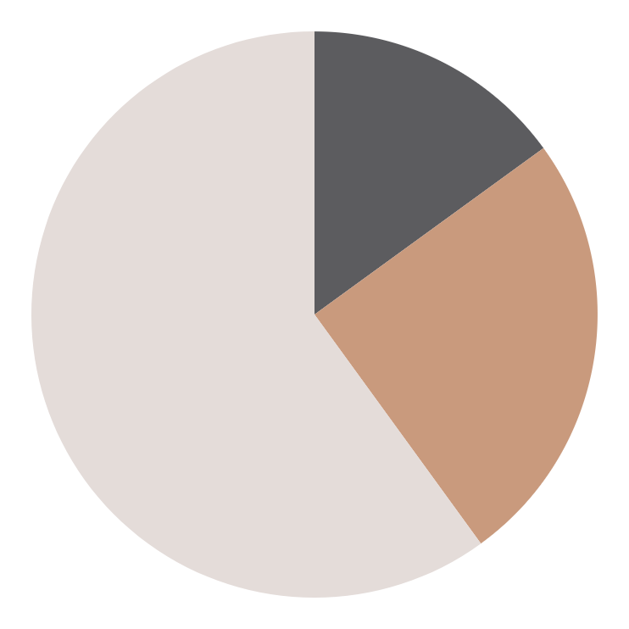
Analysis of the results
15% - Mercury
25% - Venus
Mercury is the smallest planet of them all
Venus is extremely hot, even more than Mercury
60% - Mars
Despite being red, Mars is actually a cold place
Follow the link in the graph to modify its data and then paste the new one here. For more info, click here

Slide 30
This is a map
Venus
Venus is the second planet from the Sun
Mercury
Mercury is the closest planet to the Sun
Mars
Despite being red, Mars is a very cold place

Slide 31
Discussion
Mars
1
Discussion 1
Despite being red, Mars is actually a cold place. It's full of iron oxide dust, which gives the planet its reddish cast. Earth is the third planet from the Sun and the only one that harbors life in the Solar System. This is where we all live:
Ceres is located in the main asteroid belt
The Moon is Earth’s natural satellite
Neptune is very far away from us
Pluto is now considered a dwarf planet
Neptune is the farthest planet from the Sun. It’s also the fourth-largest planet by diameter in the Solar System
2
Discussion 2
Venus has a beautiful name and is the second planet from the Sun. It’s terribly hot—even hotter than Mercury

Slide 32
Conclusions
Mars
Venus
Despite being red, Mars is actually a cold place. It’s full of iron oxide dust
Venus has a very beautiful name and is the second planet from the Sun
Mercury
Neptune
Mercury is the closest planet to the Sun and the smallest one in the Solar System
Neptune is the fourth-largest planet by diameter in the Solar System

